Slide 1
TRANSNASAL DELIVERABLES Pharmaceutical Delivery Systems “Urgent Medicine Delivery When Every Second Counts”

Slide 3
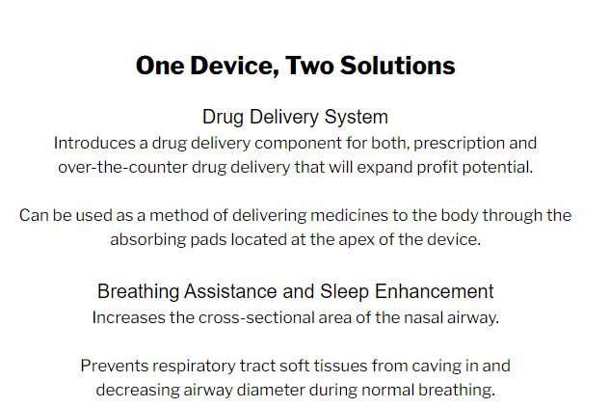

Slide 5
Patent Protection

